Slide 1

Views, Routing,
and URLs

Slide 2
Django
We now understand how to create a Django Project and create a Django App within that Project.
We’ve also explored a little bit about creating Views and routing them through URLs.
This section dives deeper into Views and URLs.

Slide 3
Django
Section Overview:
Project and App Review
Routes and URLs
Basic Function Views
Dynamic Views and View Logic
Redirects and 404s
URL names and reverse()
Connecting to Templates

Slide 4
Django
In this series of lectures we won’t yet connect views to .html template files.
We will just focus on how Views connect to URL routes first, before passing information to a template.
The next section will cover the relationship between templates and views in much more detail.

Slide 5
Django
Note that we will only discuss function based Django views.
Later on we will discuss CBVs (Class Based Views), but we’ll need to learn about Models first!

Slide 6
Let’s get started!

Slide 7
Project and App
Creation Exercise

Slide 8
Django
This very quick exercise is to review the two key command line processes that create Django Projects and Django Apps!
Your Task:
Create a Django Project called “my_site” with an App called “first_app”.

Slide 9
Project and App
Creation Exercise
Solution

Slide 10
Views and URLs
Overview

Slide 11
Django
In Django, Views dictate what information is being shown to the client, and URLs dictate where that information is shown on the website.
These work in concert so you can think of each View/URL pairing as a web page on the website.

Slide 12
Django
Keep in mind that not every permutation of a webpage can be known in advance, for example, “How many total blog posts will a website blog eventually have?”
Django Views and URLs support a lot of dynamic and logic features to help with this sort of task.

Slide 13
Django
Recall that we have URL configurations at a Project level and at an App level.
We connect these through the use of path() and include() Django functions.
A list of view routes is defined in a list variable called urlpatterns.

Slide 14
Django
Django Project
my_site
settings.py
admin.py
urls.py
my_app
views.py
urls.py

Slide 15
Django
Connecting a View to a URL with path():
route
String code that contains the URL pattern.
Django will scan the relevant urlpatterns list until it finds a matching string route (e.g. “app/”)

Slide 16
Django
Connecting a View to a URL with path():
view
Once a matching route is found, the view argument connects to a function or view, typically defined in the views.py file of the relevant Django app.

Slide 17
Django
Connecting a View to a URL with path():
kwargs
Allows us to pass in keyword arguments as a dictionary to the view.
name
Allows us to name a URL in order to reference it elsewhere in Django.

Slide 18
Django
Coming up next we’ll create some simple views in our app and connect them to our Project URL routes.

Slide 19
Function Views Basics

Slide 20
Dynamic Views
and Logic

Slide 21
Django
Let’s now explore two key ideas:
Adding in Logic to a View
Creating Dynamic Paths
URL Path Routes defined by the client.

Slide 22
Responses and 404s

Slide 23
Django
Inevitably there will be a time when a client requests a web page view that does not exist or the client did not provide the correct URL route.
In these cases, we can use HttpResponseNotFound() to still return a webpage for the user.

Slide 24
Django
Django also has a default 404 page we can display.
Later on when we dive deeper into templates we’ll see how to create our own custom 404 page.

Slide 25
Redirects

Slide 26
Django
Sometimes a client user will provide a path that we want to redirect to another webpage on our site.
This can be accomplished in Django through the use of the HttpResponseRedirect() function.

Slide 27
Django
Let’s imagine that we want to match our website newspaper article pages to the numeric page in the physical newspaper for readers to quickly find an article online.
For example, if Finance was on page 2 of the newspaper, we want to redirect first_app/2/ to first_app/finance/.

Slide 28
Django
Note!
The example shown here is not the typical way we’ll redirect pages, it is actually error-prone, which we’ll talk about in the lecture.

Slide 29
Django
Let’s explore a very simple redirect syntax example, then we’ll discuss some more details behind it in the next lecture.

Slide 30
URL Names
and Reverse()

Slide 31
Django
As our websites get larger and more complex, we’ll keep adding more views and more URLs across the project and apps.
This leads to more instances where we’ll need to reference existing pages (URLs on across our website).

Slide 32
Django
In this lecture we’ll explore two key ideas:
URL Paths inside the path() function can have names that can be referenced across Django and inside of a template.
Django has a reverse() function to find the corresponding URL path for a URL name.

Slide 33
Django
What is the typical flow for a webpage?

Slide 34
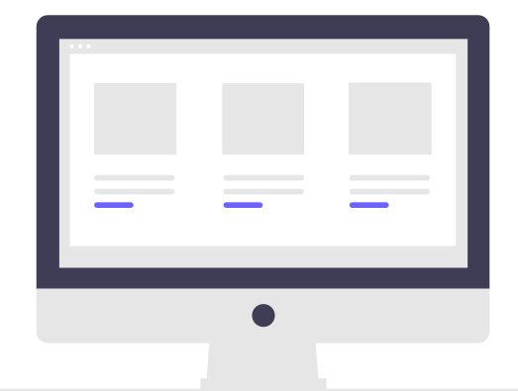
Django
What is the typical flow for a webpage?
User

Slide 35
Django
What is the typical flow for a webpage?
URL
User

Slide 36
Django
What is the typical flow for a webpage?
URL
User
urls.py

Slide 37
Django
What is the typical flow for a webpage?
URL
User
urls.py
views.py

Slide 38
Django
What if the request for the URL is in views?
URL
User
urls.py
views.py

Slide 39
Django
What if the request for the URL is in views?
views.py
URL
User
urls.py

Slide 40
Django
What if the request for the URL is in views?
views.py
def redirect_view(request):
return HttpReponseRedirect(some_url)
URL
User
urls.py

Slide 41
Django
What if the request for the URL is in views?
views.py
def redirect_view(request):
return HttpReponseRedirect(some_url)
URL
User
urls.py

Slide 42
Django
Django reverse() function!
views.py
def redirect_view(request):
webpage = reverse(url_name)
return HttpReponseRedirect(webpage)
URL
User
urls.py

Slide 43
Django
Django reverse() function!
views.py
def redirect_view(request):
webpage = reverse(url_name)
return HttpReponseRedirect(webpage)
URL
User
urls.py

Slide 44
Django
Let’s name a URL and then use it inside a reverse() call for Django.

Slide 45
Connecting to Templates

Slide 46
Django
Realistically we don’t want to have to manually type out HTML code or HTTP Responses inside our views.py file.
Instead, we would like to separate out all our templates (HTML files) into a separate directory and have views communicate between this directory and render the templates.

Slide 47
Django
Connecting to a template directory requires us to inform the Django project settings where to find these templates.
In this simple example, we’ll store all the templates at a project level.
Later on we’ll explore how to store templates on a Django app level (recommended way of doing things).

Slide 48
Django
In this lecture we’ll:
Create a new templates directory
Create an example .html file
Connect to that .html within the view
Inform the Django project where to find this template directory inside of settings.py

Slide 49
Views and URLs
Exercise Overview

Slide 50
Views and URLs
Exercise Solution

